Slide 1
Taxonomy Analysis Report
Sissy X. Zheng

Slide 2
OBJECTIVE

Slide 3
Analysis Objective
The objective of this analysis is to evaluate whether rarely used Video Descriptors can be deleted based on the following five dimensions:
VDs Creation Year: Assess the age of the Video Descriptors to determine its relevance over time.
Correct Usage of VDs: Evaluate whether the Video Descriptors have been used correctly and consistently.
DE&I (Diversity, Equity, and Inclusion) and Market Significance: Analyze the importance of Video Descriptors in promoting diversity, equity, and inclusion, as well as their significance in the market.
Future Trend Predictions: Forecast future trends to assess the potential relevance of the Video Descriptors.
Importance of Types in Client Carousels: Determine the significance of Video Descriptor types when clients use carousels, focusing on their importance and impact.

Slide 4
METHODS

Slide 5
Data Set Selection
1. Adjusted frequency report considering the creation year using the mathematical model.
Applied an exponential decay function based on the years since creation to lower the frequency of older VDs.
Step 1: Calculate Years Since Creation
Step 2: Adjusted Frequency: Adjusted frequency = Original frequency + 2
Add a small constant (e.g., 2) to the frequency to avoid the issue of zero frequency.
Step 3: Log Adjusted Frequency: Log adjusted frequency = ln^{(adjusted frequency)}
Use the logarithmic function to balance the range of different frequencies.
Step 4: Time Decay Factor: Time decay factor =e−decay rate×years since creation (decay rate:0.2)
Step 5: Final Adjusted Frequency: Multiply the log adjusted frequency by the time decay factor.

Slide 6
Data Set Selection
Study Scope
Years since creation | Frequency | Final Adjusted Frequency(0.2) | Percentile
5 | 0 | 0.2549945974 | 5th
3 | 0 | 0.3804072382 | 5th
5 | 1 | 0.4041568748 | 5th
2. Percentile the Final adjusted Frequency and select the data set
Selected the lowest 5% of Terminal VDs as the source for detailed analysis.
VD Type | COUNT of VDs
Type A | 56
Type B | 4
Type C | 90
Type D | 12
Type E | 7
Type F | 18
Type G | 11
Type H | 15
Type I | 4
Type J | 13
Type K | 238
Type L | 28
Type M | 120
Grand Total | 616
The percentile of the final adjusted frequency
Percentile | Final Adjusted Frequency(0.2)
1th Percentile | 0.2549945974
5th Percentile | 0.4041568748
10th Percentile | 0.5920791198
80th Percentile | 2.168429621
90th Percentile | 2.55084263
95th Percentile | 2.879554474
99th Percentile | 3.508100739

Slide 7
B. Statistical Model Under the Influence of Four Factors
Final Composite score = The score of Program Factor * 0.25 + The score of DE&I Factor * 0.25 +The score of Type weight Factor * 0.25 +The score of Popularity Prediction Factor * 0.25
Program Factor: To measure whether a VD is being correctly used.
DE&I Factor: Designing a scale considering DE&I (Diversity, Equity, and Inclusion) and emerging market factors to rate each VD.
Type Weight Factor: Incorporate our own VD type classification and Roku company's actual carousels to design weights for each type.The purpose of this factor is to demonstrate the importance of each type in the actual usage of carousels by clients.
Popularity Prediction Factor: To gauge future trends for a keyword, analyze upcoming programs set for release in the next three years and monitor social media attention to measure the "buzz."
Factors | Weight
Program Factor | 0.25
DE&I Factor | 0.25
Type weight Factor | 0.25
Popularity Prediction Factor | 0.25

Slide 8
1. Program Factor
ChatGPT Utilization:
Find programs where the VDs can be tagged.
Criteria for Identified Programs:
Must have an existing IMDb page.
Must be documented on Wikipedia in any language.
Exclude categories such as Sports, music videos, paid programming, local programming, or adult content.
Must have substantial film production quality.
Distributed through cinemas or mainstream media channels globally.
Keywords should not pertain to the author, director, actor, or actress unless they are also characters.
Film or TV show must primarily focus on the keywords.
Weighted Sum Model:
Weight Allocation:
Program 1: 0.4
Program 2: 0.4
Program 3: 0.2
Composite Score Calculation:
Composite score of Program factor = Program1 * 0.4 + Program2 * 0.4 + Program3 * 0.2

Slide 9
2. DE&I Factor - DE&I (Diversity, Equity, and Inclusion) Assessment Scale
Five Criteria:
Nationalities: Represents people or a group of people belonging to a particular nation or country. Indicates nation or country association by citizenship, heritage, or cultural affiliation.
Sexual Orientations: Relates to patterns of emotional, romantic, or sexual attraction. Reflects how people experience and express their sexual orientation or identity.
Gender Identities: Pertains to how individuals perceive, experience, and express their gender, including non-binary, genderqueer, or genderfluid identities.
Disabilities: Represents physical, mental, or sensory impairments affecting daily activities or societal participation.
Emerging Markets: Significance if the keyword's culture, origin, or basis comes from countries outside North America or Europe.
Scoring Criteria:
1 point: Program does not match the criterion.
3 points: Program partially matches the criterion.
5 points: Program fully matches the criterion.
Please note: To address the imbalance caused by the disproportionately high DE&I scores compared to other factors, I applied the "min-max normalization" method, a standard data preprocessing technique, to linearly map the data to a specified range (from 0% to 100%).

Slide 10
3. Type weight Factor
Type | Nielsen | ROKU | Average Weight | Logarithmic Transformation | Final Adjusted Weights
A | 14.29% | 12.50% | 13.91% | 2.46834733 | 13.00%
B | 14.29% | 12.50% | 13.91% | 2.356025857 | 12.41%
S | 14.29% | 12.50% | 13.91% | 2.749736316 | 14.49%
C | 14.29% | 1.25% | 8.07% | 3.620031895 | 11.06%
S | 14.29% | 12.50% | 13.91% | 2.181843588 | 11.49%
T | 4.76% | 12.50% | 8.97% | 2.559906625 | 8.69%
P | 4.76% | 1.25% | 3.12% | 3.164650216 | 3.74%
A | 4.76% | 1.25% | 3.12% | 2.978180517 | 3.52%
D | 1.79% | 6.25% | 4.17% | 3.174350597 | 5.02%
R | 1.79% | 1.25% | 1.58% | 2.588831726 | 1.55%
C | 1.79% | 1.25% | 1.58% | 3.001733713 | 1.79%
A | 1.79% | 1.25% | 1.58% | 2.64246452 | 1.58%
B | 1.79% | 1.25% | 1.58% | 2.499687083 | 1.49%
D | 1.79% | 12.50% | 7.42% | 2.298853076 | 6.46%
F | 1.79% | 1.25% | 1.58% | 3.23146959 | 1.93%
G | 1.79% | 1.25% | 1.58% | 2.974511693 | 1.78%
Nielsen’s classification ratios
The proportion of each VD type as it relates to Nielsen’s overall classification framework
Roku’s Carousel descriptor group ratios.
The relative importance of each category based on Roku’s classification criteria.
Total Count Factor
Use the total count of VDs within each category as a weight adjustment factor.
Applied the Logarithmic Transformation Model to adjust the average weight of Nielsen and Roku’s ratio.

Slide 11
4. Popularity Prediction Factor
Composite Score of Popularity Prediction Factor = 50%*upcoming program + 50% * Attention score
Future Program Availability (Weight 50%)
Utilized Chat GPT to search the IMDb and Box Office Mojo websites for upcoming programs related to the VDs.
Domestic Films and TV Shows: Data from Box Office Mojo covers releases for the next three years.
International Films and TV Shows: Data from IMDb covers releases for the next year.
Social Media Attention (Weight 50%)
Utilized Chat GPT to assess the level of social media attention for a VD, categorizing it into three levels
Low Attention (0 points)
Medium Attention (0.5 points)
High Attention (1 points)

Slide 12
RESULTS

Slide 13
1. Descriptive Statistics
 | Program Factor | DE&I Factor | Type weight Factor | Popularity Prediction Factor | Composite Score
count | 616 | 616 | 616 | 616 | 616
mean | 0.4071 | 0.2334 | 0.0384 | 0.1396 | 0.19601
std | 0.2971 | 0.3199 | 0.0280 | 0.1548 | 0.10780
min | 0 | 0 | 0.0149 | 0 | 0.00045
25% | 0 | 0 | 0.0193 | 0 | 0.10125
50% | 0.4 | 0 | 0.0193 | 0.25 | 0.20048
75% | 0.8 | 0.4 | 0.0502 | 0.25 | 0.26338
max | 1 | 1 | 0.1149 | 1 | 0.55277

Slide 14
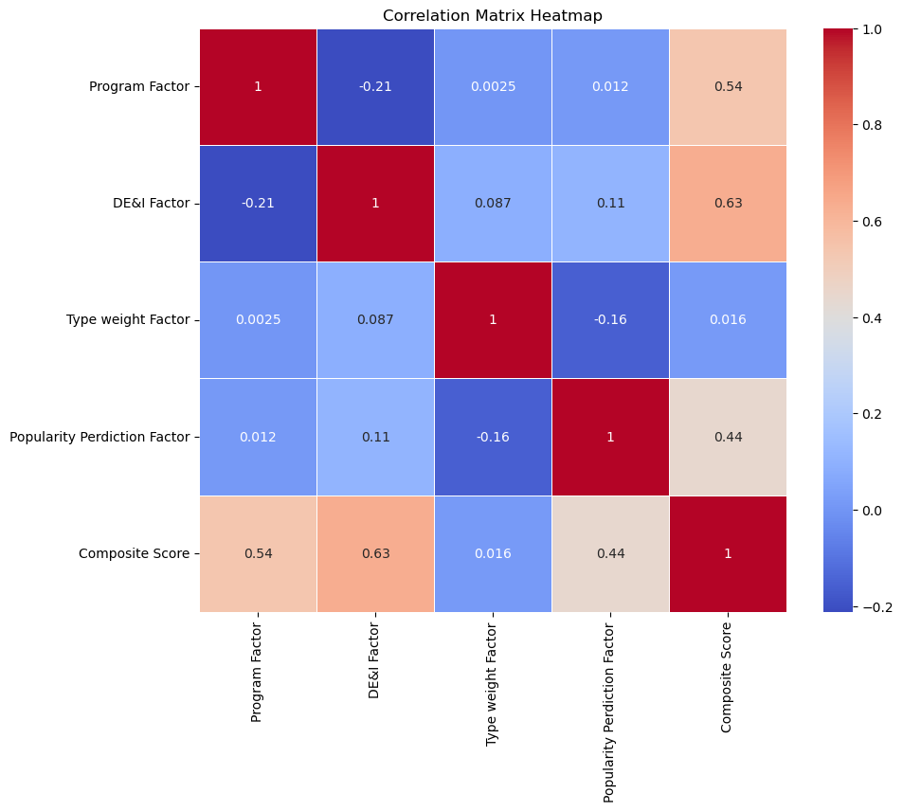
2. Correlation Analysis
The correlation matrix heatmap reveals significant insights into the relationships between various factors and the Composite Score.
The DE&I Factor (0.63) emerges as the most influential predictor, followed by the Program Factor (0.54) and the Popularity Prediction Factor(0.44).
The Type Weight Factor (0.016) shows no significant correlation with the Composite Score.

Slide 15
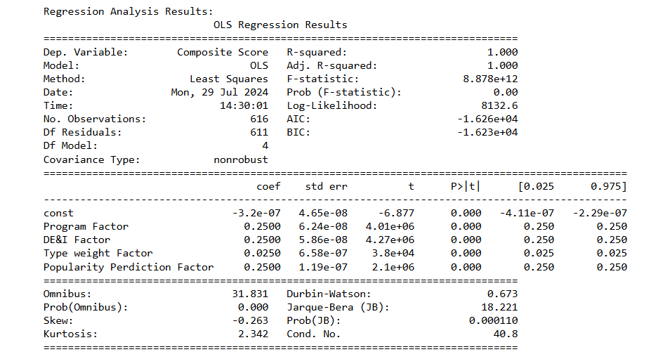
3. Regression Analysis
The R-squared value of 1.000 indicates a perfect fit, meaning the model explains all the variability in the composite score. All factors—Program Factor, DE&I Factor, Type Weight Factor, and Popularity Prediction Factor—are statistically significant predictors of the composite score (p-values < 0.05).

Slide 16
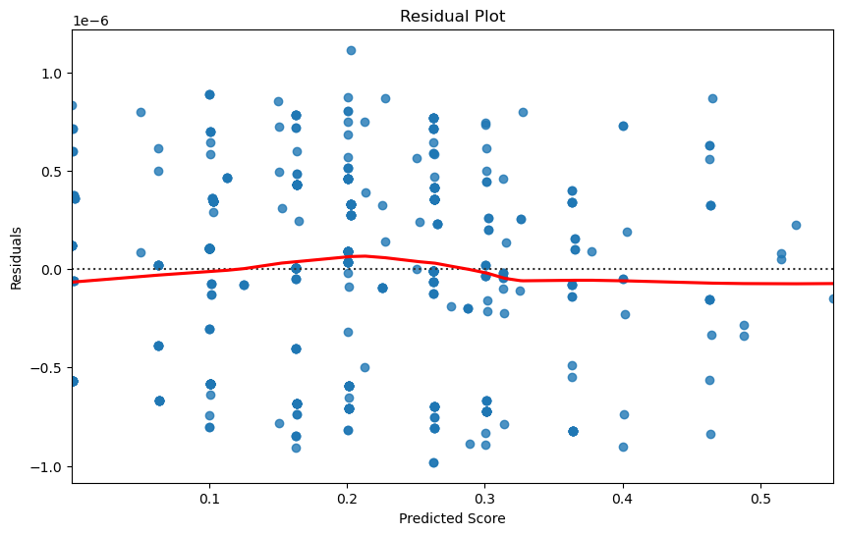
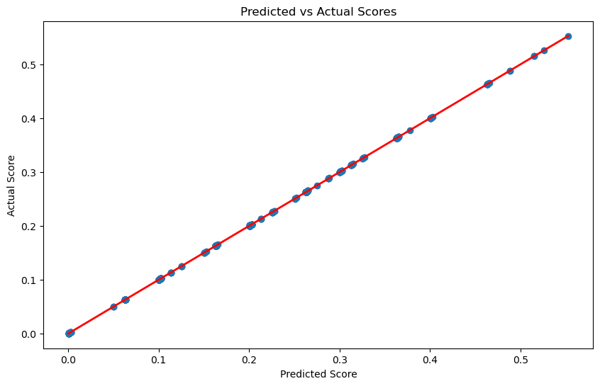
3. Regression Analysis
The residuals are randomly scattered around zero, suggesting that the model's assumptions are met and indicating no obvious patterns or biases in the predictions. The small scale of residuals (in the order of 1e-6) further supports the model's accuracy.
The points lie almost perfectly on the red line, indicating that the model's predictions closely match the actual values, further confirming the model's accuracy.

Slide 17
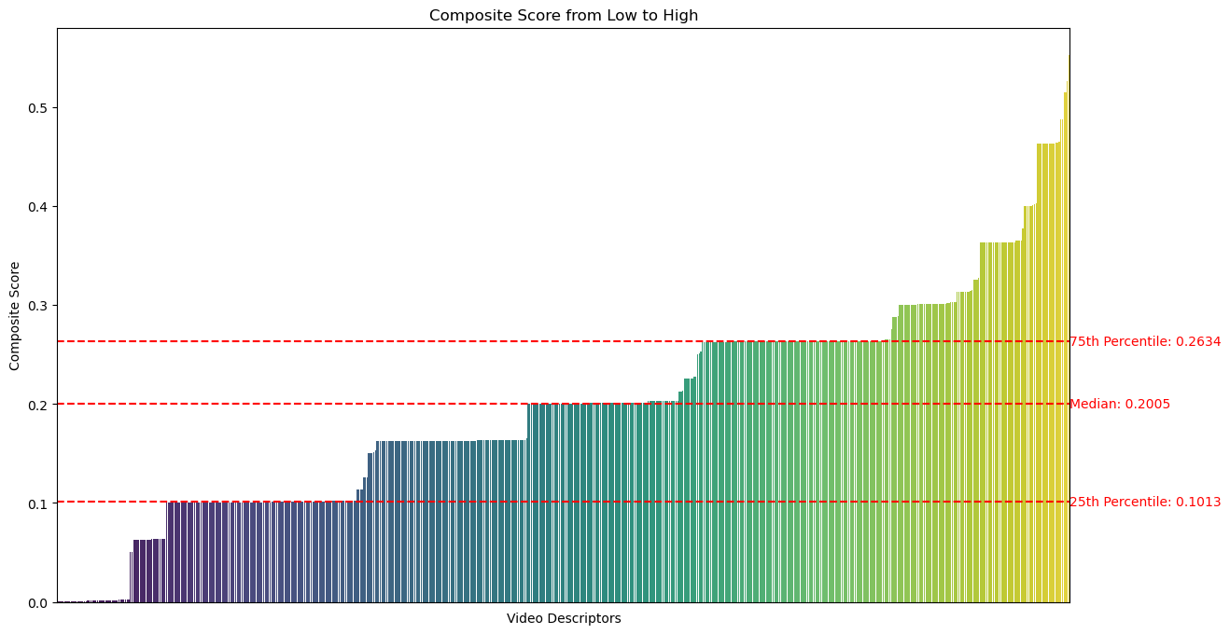
4. Final Composite Score Analysis
The bar chart displays the distribution of composite scores from low to high, with key percentiles highlighted.

Slide 18
DISCUSSION

Slide 19
Key Percentile Points and Observations
Zone 1: 0-0.10277 (Near the 25th Percentile)
Description: This zone includes two sub-groups:
Keywords where three out of the four factors (excluding Type Weight Factor) have scores of zero.
Keywords where one of the three factors (excluding Type Weight Factor) has a small score.
Recommendation: This zone is designated as the Deletion Zone. Keywords in this zone are suggested for removal due to their low overall scores.
The number of the descriptors: 180
Zone 2: 0.10278-0.20287 (Near the 50th Percentile)
Description: This zone includes two sub-groups:
Keywords where one of the three factors (excluding Type Weight Factor) has a relatively high score.
Keywords where two out of the three factors (excluding Type Weight Factor) have small scores.
Recommendation: This zone is designated as the Controversial Zone. Keywords in this zone are recommended for temporary retention. It is suggested to re-evaluate these keywords after three years during the next taxonomy review, and decide on their deletion based on their performance at that time.
The number of the descriptors: 274
Zone 3: 0.20288-0.55277
Description: Keywords in this zone typically exhibit a significant advantage in two or three of the factors.
Recommendation: This zone is designated as the Retention Zone. Keywords in this zone are suggested for retention due to their higher overall scores, indicating strong performance in one or more factors.
The number of the descriptors: 162

Slide 20
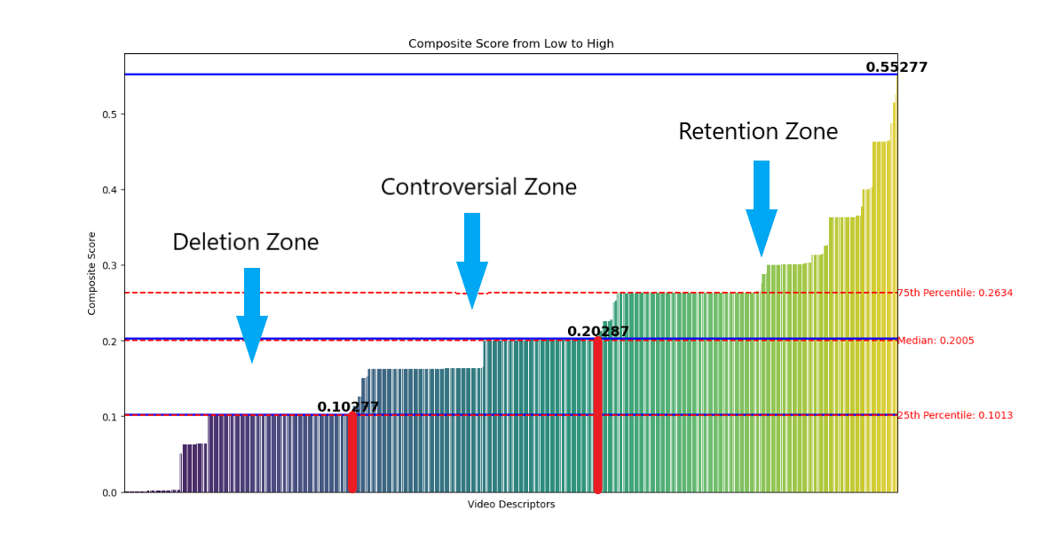
[162]
[274]
[180]

Slide 21
CONCLUSION

Slide 22
Terminal Video Descriptors Deletion Recommendation
In my research, which encompassed 616 video descriptors, the analysis revealed three distinct zones based on composite scores.
The Deletion Zone comprises 180 terminal VDs with minimal factor scores, suggesting they are not performing well and should be removed.
The Controversial Zone includes 274 terminal VDs with moderate scores, which require further observation and evaluation before making a final decision.
The Retention Zone contains 162 terminal VDs with strong performance in one or more factors, indicating their importance and the need for retention.
Deletion Zone
Type | COUNT
Type A | 15
Type B | 4
Type C | 8
Type D | 6
Type E | 8
Type F | 3
Type G | 9
Type H | 2
Type I | 74
Type J | 3
Type K | 48
Grand Total | 180

Slide 23
2. Removing Non Performing Terminal Video Descriptors Under Specific Being/group and Specific Location Type
There are 146 terminal VDs without a specific information under the specific being/group and specific location type that are deemed meaningless.
As we are upgrading the Video Descriptors taxonomy rather than using the Global Media Ontology, it is recommended to delete these meaningless VDs.
This will help ensure that the taxonomy remains relevant and efficient by focusing only on VDs that add value.

Slide 24
3. Recommendation Period for Maintenance
Research Scope Definition:
Applied Time Decay function with a decay rate of 0.2.
Included keywords created 3 to 5 years ago.
Recommendation:
Perform comprehensive database cleanup every 3 to 5 years.
Remove outdated and non performing keywords.

Slide 25
Thank you!

